Slide 1
CSS 422 Hardware and Computer Organization
68K Instruction Set
Professor: Yang Peng
The slides are re-produced by the courtesy of
Dr. Arnie Berger and Dr. Wooyoung Kim

Slide 2
Today’s Topic
MC68000 instruction set
Chapter 3, 5 by Clements (Available online)
68K manual
Online source, http://www.engineering.uiowa.edu/~carch/lectsupp09/68kSimplifiedHandout.pdf

Slide 3
68000 Instruction Set
Assembler Directives (Pseudo Op Code)
ORG, EQU, END, DC, DCB, DS, etc.
Instructions (Op Code)
Data Movement and Arithmetic operations
Logical, Shift and Bit operations
Program Control
System Control

Slide 4
Pseudo OP Code

Slide 5
Pseudo Op Codes – Assembler Directives
Data Storage Directives
Tells the assembler to allocate blocks of memory for data storage
DC - Define Constant
Format: <label> DC.<size> <item>,<item>,<item>…..
Can store more than one byte
The <size> specifies the boundary but not the size of each item
Example: date_msg DC.W ‘April 8’ *stored as 8 but not 7 bytes
DCB - Define Constant Block
Format: <label> DCB.<size> <length>,<value>
Initializes a block of memory to the same value
The length is the number of bytes, words, or long words
Example: Repeat_msg DCB.B 4, $54

Slide 6
Pseudo Op Codes – Assembler Directives
DS - Define Storage
Generates an uninitialized block of memory
Allocate a space for the result, most of cases
Format: <label> DS.<size> <length>
END - End of Source file
Everything after END is ignored
Format: END <address>
The END pseudo-op also instructs the simulator where to load the program in memory
The <address> is typically the address of ORG
Note: ORG and END are complementary
ORG instructs the assembler how to resolve address references
END instructs the loader where to put the code in memory
They don’t necessarily to be the same!
But, we always want to make them using the same address in our code in this class

Slide 7
Hardware Organization of the MC68000
Holds address
of the next instruction
to be executed
If necessary
Holds the address
of memory reads/writes
Program Counter (PC) 32
Effective Address Register (EAR) 32
Memory
and I/O
Interface
Control
Pipeline
External
Bus
Internal Bus
Instruction
Register(IR)
16
General Registers
D0..D7
A0..A6
A7= User Stack pointer (USP)
A7’=Supervisor Stack Pointer(SSP)
Instruction
Decode
and Control
Holds first word
of currently
executing instruction
32
Temporary Register 32
Holds operands or
intermediate results
Performs all logical
or arithmetic
operations
( ADD, SHIFT, etc. )
Arithmetic and Logic Unit
(ALU)
8
CCR
Status Register
32
Holds result of ALU
Operations

Slide 8
User Programming Model
For most applications the architectural model of the 68000 is the User Programmer’s Model
31 16 15 8 7 0
USER STACK POINTER - USP
D0
31 16 15 0
D1
A7
D2
D3
D4
PROGRAM COUNTER - PC
31 0
D5
PC
D6
D7
CONDITION CODE REGISTER - CCR
7 4 3 2 1 0
31 16 15 0
A0
X N Z V C
A1
CONDITION CODES (FLAGS)
C = Carry Flag
V = Overflow Flag
Z = Zero Flag
N = Negative Flag
X = Extend Flag
A2
A3
A4
A5
A6

Slide 9
TRAP #15 task
http://www.easy68k.com/QuickStart/TrapTasks.htm
TRAP #15 is used for Input/Output
How to use? Practice with Lab1!
MOVE.B #number, D0
TRAP #15
#number 14 – Display the NULL terminated string at (A1) without CR, LF.
#number 4 – Read a number from the keyboard into D1.L.
Based on what you put in the D0, you will have different I/O tasks
For your project, you cannot go beyond #number 14!

Slide 10
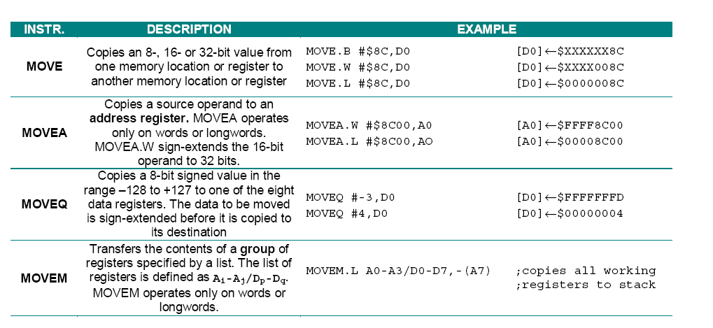
Data Movement Instructions
Move operands (data) among memory or registers

Slide 11
MOVE <ea>, <ea>
Copies a byte, word or long from one location to another
Source effective address: All the addressing modes
Destination effective address: All except immediate, address register direct and program counter relative addressing
CCR bit: V and C are cleared, N and Z are updated according to the value of the destination operand, X is unaffected. (XNZVC = ?**00)
For example,
MOVE.B #$8C, D0 results in XNZVC set to → ?1000
MOVE.B #0, D0 results in XNZVC set to → ?0100
Bug report for easy68K simulator!
MOVE.L #(data<5bits), D0→ assembled to MOVEQ instruction
Address register as the destination is considered valid (changed to MOVEA)

Slide 12
MOVEA <ea>, An
Copy an Address value from source to destination
Source effective address: All the addressing modes
Destination effective address: only Direct Address Register
Can only take .W and .L
Does not affect the state of the CCR
Words are sign extended when moved into the register
MOVEA.W #$8C00, A0 [A0] ← $FFFF8C00
MOVEA.W #$4F00, A0 [A0] ← $00004F00
Longwords are just an absolute longword address
MOVEA.L #$8C00, A0 [A0] ← $00008C00

Slide 13
MOVEA
What value will you see in A1 after the following operations?
MOVEA.W #$7FFF, A1
$7FFF = % 0111 1111 1111 1111 ➔ % 0000 0000 0000 0000 0111 1111 1111 1111
= $ 0000 7 FFF
MOVEA.W #$8000, A1
$8000 = % 1000 0000 0000 0000 ➔ % 1111 1111 1111 1111 1000 0000 0000 0000
= $ FFFF8000
MOVEA.L #$8000, A1
Then A1 contains $00008000

Slide 14
More about MOVEA
Addresses are signed numbers!
Why need negative number?
For the reverse direction, instead of forwarding
Why not just use Long-word addresses only?
Saves memory space
Requires one less extension word fetch
ROM code is usually placed in low or high memory
MOVEA and some other Address Operation instructions can
explicitly specify word and long address (MOVEA.W, MOVEA.L)
sign extend the address automatically
What about other instructions?

Slide 15
LEA <ea>, An
Source → An
Load effective address
Does not affect the state of the CCR
Size = Longword
Source effective address:
(An), An, Absolute addressing (Word, Long)
LEA $A000, A0 [A0] ← $0000A000
LEA (A2), A0 [A0] ← [(A2)]
Is “LEA $A000, A0” the same as “MOVEA.W #$A000, A0” ?
No. LEA does not allow word-address. So, all values are considered longword addresses → no sign extension!
After “MOVEA.W #$A000, A0”, A0 has FFFFA000

Slide 16
MOVEQ #<data>, Dn
Move Quick instruction copies one byte immediate data as
8-bit signed value (-128~127) to a data register
Cannot copy the data out of range
The data to be copied is sign-extended before it is copied to its destination
CCR bit: V and C are cleared, N and Z are updated according to the value of the destination operand, X is unaffected. (XNZVC = ?**00)
Data is saved into data register as Longword (smaller values are sign-extended)
MOVEQ #-3, D0 [D0] ← $FFFFFFFD
(-3 = 11111101 with 8-bits)
MOVEQ #4, D0 [D0] ← $000000004

Slide 17
MOVEM <register list>, <ea> MOVEM <ea>, <register list>
Transfers the contents of a group of registers specified by a list. The list of registers is defined as Ai-Aj/Dp-Dq.
MOVEM operates only on words or longwords.
Use assembler directive REG to bind a name to the list
MOVEM.L A0-A6/D0-D7, -(SP)
GROUP REG A0-A6/D0-D7
MOVEM.L GROUP, -(SP)

Slide 18
Pseudo Op Codes – Assembler Directives
REG - Register Range
Allows a list of registers to be defined
Format: <label> REG <register list>
Registers may be specified as a single register, An or Dn, separated by slashes, i.e. A1/A5/A7/D1/D3
Register ranges may also be specified, i.e., A0-A3
Thus:
save_reg REG A0-A3/A5/D0-D7
Refer to the MOVEM instruction in your programmer’s manuals
Will go over again for subroutine

Slide 19
MOVEM <register list>, <ea> MOVEM <ea>, <register list>
Mostly used with pre-decrementing (registers to memory) and post-incrementing (memory to registers)
Frequently used to save working registers on entering a subroutine and to retrieve them on exiting the subroutine
MOVEM.L A0-A6/D0-D7, -(A7) *copies all working registers to stack
MOVEM.L (A7)+, A0-A6/D0-D7 *Restore the registers
WHY do you need to save the registers to the stack when entering a subroutine??

Slide 20
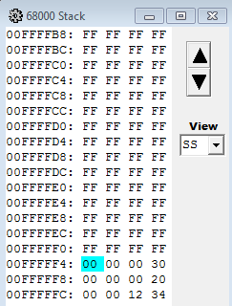

68K Always writes to memory in the order of A7 to A0, D7 to D0
68K Always reads from memory in the order of D0 to D7, A0 to A7
E.g., D0 has $30, D1 has $20, A3 had $1234
SP
MOVEM.L D0/D1/A3, –(SP)
$30
$20
$1234
SP
Before executing
After executing

Slide 21
Data Movement Instructions
Move operands (data) among memory or registers

Slide 22
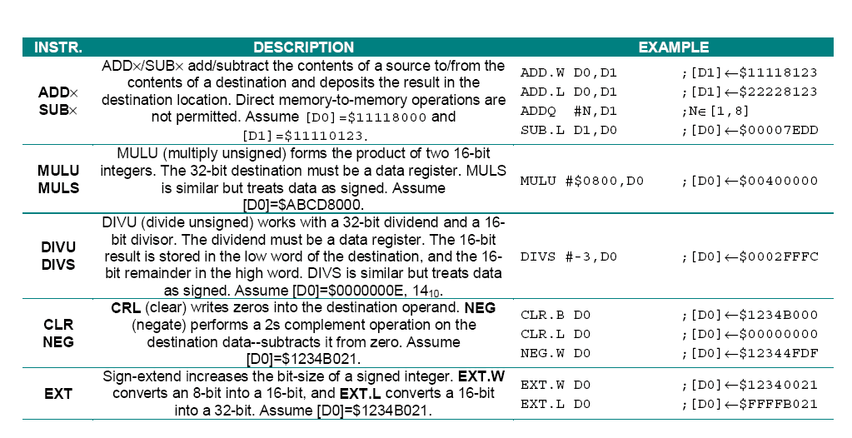
68000 Arithmetic Instructions
68K has a conventional set of integer arithmetic operations.
68K does not support floating-point operations.
[D0] ← 04000000

Slide 23
ADD
ADD (Add binary)
A data register must be the source or destination of an ADD instruction
ADD <ea>, Dn or ADD Dn, <ea>
Direct memory-to-memory additions are not permitted
Example:
Before: <D2> = $12345678, <D3> = $5F02C332
ADD.B D2,D3
After: <D2> = $12345678, <D3> = $5F02C3AA (XNZVC = 01010)
CCR bits are changed based on the result
X : EXTEND flag: Used in certain operations, generally affected like CARRY
N : NEGATIVE flag: if Bit 7 is 1, then N=1
Z : ZERO flag: if zero, Z=1
V : OVERFLOW flag
C : CARRY flag

Slide 24
ADDA and ADDQ
ADDA (Add Address): Adds data to an address register
Only word and longword operations are allowed
ADDA.W #$8122, A0 ; [A0] ← $FFFF8122 + A0 (sign-extended)
CCR is not affected
ADDQ (Add Quick): Adds a number in the range 1 to 8
3-bits can represent 1 - 8, (Note: 8 being 000 here)
Word and longword size when the destination is an address register
If destination is address register, CCR is not affected
Faster as the immediate data is just 3 bits
ADDQ, SUBQ support operands 1 to 8 only and not sign-extended

Slide 25
ADDI
ADDI (Add Immediate): Adds number to data register or memory
Byte, word or longword operations
ADDI.W #$1234, (A0) is valid
ADD.W #$1234, (A0) is invalid
Question: If <D2> = $047128E8, what’s the difference between
ADDI.B #$20,D2 * <D2> = ??, C = ??
$04712808
C=1
ADDI.W #$20,D2 * <D2> = ??, C = ??
$04712908
C=0

Slide 26
MULU and MULS
MULU (multiply unsigned) , MULS (multiply signed)
MULU <ea>, Dn
MULS <ea>, Dn
Product of two 16-bit integers (Only Word is allowed)
Only lower order word is used in multiplication: upper word is unused
[D0] = $ABCD8000
MULU #$0800, D0 ; [D0] ← 04000000
CCR Bits
X: unchanged
V = C = 0
N and Z depend on the result

Slide 27
DIVU and DIVS
DIVU (divide with unsigned) , DIVS (divide with signed)
DIVU <ea>, Dn
DIVS <ea>, Dn
Destination ÷ Source → Destination
Destination is longword, Source is word
The quotient is in the lower-order word
The remainder is in the upper-order word
CCR bits
X: unchanged
N, Z: depends on the quotient, but if V=1 or divide by zero then undetermined
V: 1 if overflow occurs. If divide zero, then undetermined
C: 0

Slide 28
CLR, CMP and EXT
CLR (Clear an operand)
May be used on bytes, words and longwords
All condition codes except X are affected
Faster than MOVE.L $0, D0
Z = 1, V=C=N = 0, X is unchanged
CMP (Compare data with a data register)
The second operand must be a data register
Sets the condition codes accordingly
Subtracts the source operand from the destination operand
Only the condition code flags are affected!
Source and destination operands are not affected!
EXT (sign-extend byte to word or word to longword)
EXT.W Dn: extend Dn(7) to Dn(8:15) (extend byte to word)
EXT.L Dn: extend Dn(15) to Dn(16:31) (extend word to longword)

Slide 29
68000 Arithmetic Instructions
68K has a conventional set of integer arithmetic operations.
68K does not support floating-point operations.
[D0] ← 04000000

Slide 30
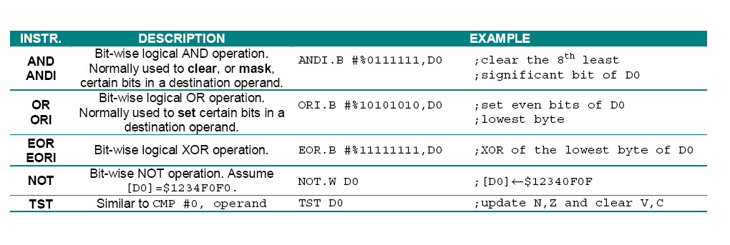
68000 Logical Operations

Slide 31
68000 Logical Operations
AND (Performs bitwise logical AND)
Example
AND.W A0,D4
“AND.W”: only the lower 16-bits of each register is used in a word operation
Example
Before: <D0> = $3795AC5F and <D1> = $B6D34B9D
AND.W D0,D1
After: <D0> = $3795AC5F and <D1> = $B6D3081D
Shortcut to remember: Any hex digit AND’ed with F returns the digit
Any hex digit AND’ed with 0 returns 0
ANDI (AND immediate data )
Example: ANDI.B #$5A,D7

Slide 32
68000 Logical Operations (2)
OR (Perform bit-wise logical inclusive OR of the operands)
ORI (Immediate bit-wise OR with destination operand)
EOR (Perform bit-wise logical Exclusive OR of the operands)
EORI (Immediate bit-wise Exclusive OR with destination operand)
NOT (Bit-wise logical complement)
Example
Before: <D3> = $FF4567FF
NOT.B D3
After: <D3> = $FF456700

Slide 33
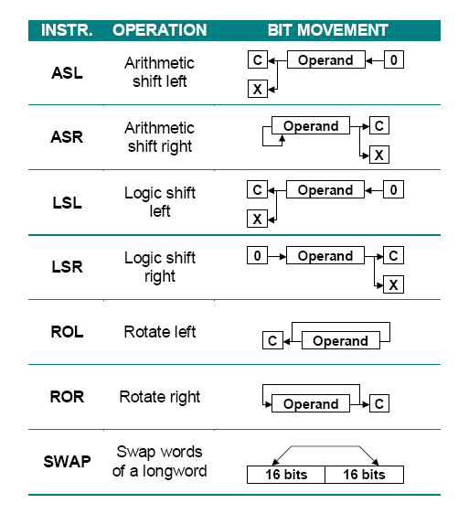
68000 Shift and Rotate Instructions

Slide 34
Arithmetic Shift
Byte, Word, Longword (careful for the data size)
V = 1 if MSB changed at any time during the shift operation
X/C = the last bit shifted out of the operand
N,Z: based on the result
ASL
Bits shift to left
New bits, 0’s, are added at the end
A bit which is shifted out goes to C-bit and X-bit
If there are multiple bits out of the end, then the last bit goes to C and X
If the sign bit has changed at the end, then V bit set
ASR
Bits shift to right
The most significant bit is preserved (to preserve the sign bit)
The bit shifted out of the end goes to C-bit and X-bit

Slide 35
ASL and ASR
ASL - Arithmetic Shift Left
X/C
0
LSB
Byte = bit 7
Word = bit 15
Long word = bit 31
ASR - Arithmetic Shift Right
X/C
LSB
Byte = bit 7
Word = bit 15
Long word = bit 31
Question:
Before: <D0> = $3456ABCF and X=0, C=0
ASL.W #3,D0
After: <D0> = ???, X/C = ???

Slide 36
Logical Shift
Byte, Word, Longword
V = 0 always
X/C = the last bit shifted out of the operand
N,Z: based on the result
LSL - Logical Shift Left
X/C
0
LSR - Logical Shift Right
0
X/C
0’s will be added, and sign bits cannot be preserved!

Slide 37
Rotate (Circular Shift)
Byte, Word, Longword
The bit shifted out of the operand moves to the position of the bit shifted in.
No bit is lost (all bits are preserved, but in different places)
V = 0 always
X: not affected
C = the last bit shifted out of the operand
N,Z: based on the result
C
C
ROL - Roll Left
ROR - Roll Right
Question:
Before: <D0> = $3456CBCF
ROL.W #3,D0
After: <D0> = ???, XNZVC = ???

Slide 38
68000 Shift and Rotate Instructions
Byte, word or long word operands
Contents of data registers D0-D7
Contents of memory locations
Shifting data in a data register: ASd #data,Dn or ASd Dx,Dy
Instruction must supply the direction, and total number of shifts/rotations
If number of shifts ≤ 8, use the immediate form
If number of shifts > 8, number must be in another data register
Example: <D0> = $0000000A
ASL.B #4,D2 *Arithmetic shift left 4 bits
LSR.W #6,D3 *Logical shift right 6 bits
ROL.L #7,D4 *Rotate left 7 bits
LSR.W D0,D5 *Logical shift right 10 bits
Shifting data in a memory location: ASd <ea>
Only one bit is shift at a time and only word operand

Slide 39
68000 Shift and Rotate Instructions

Slide 40
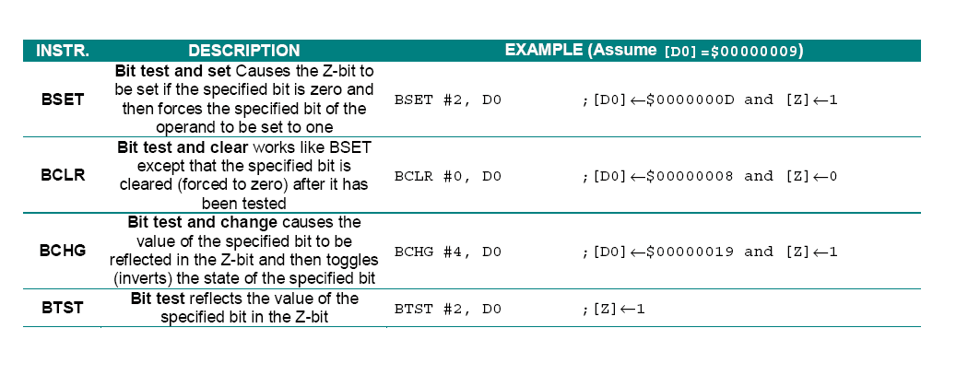
68000 Bit Manipulation
Only Z-bit in CCR is affected
Test one bit of a byte if in memory (source is modulo 8)
Test one bit of a Longword if in data register

Slide 41
Hardware Organization of the MC68000
Holds address
of the next instruction
to be executed
If necessary
Holds the address
of memory reads/writes
Program Counter (PC) 32
Effective Address Register (EAR) 32
Memory
and I/O
Interface
Control
Pipeline
External
Bus
Internal Bus
Instruction
Register(IR)
16
General Registers
D0..D7
A0..A6
A7= User Stack pointer (USP)
A7’=Supervisor Stack Pointer(SSP)
Instruction
Decode
and Control
Holds first word
of currently
executing instruction
32
Temporary Register 32
Holds operands or
intermediate results
Performs all logical
or arithmetic
operations
( ADD, SHIFT, etc. )
Arithmetic and Logic Unit
(ALU)
8
CCR
Status Register
32
Holds result of ALU
Operations

Slide 42
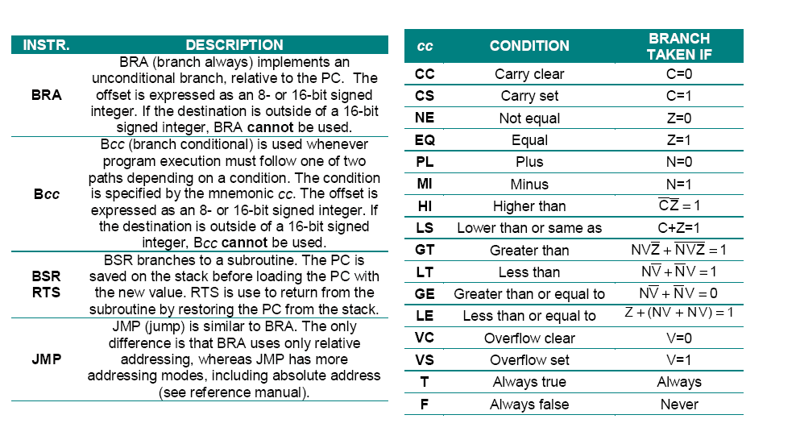
Program Control
JSR
RTS
Similar to BSR and RTS. But, JSR has more addressing modes than BSR. See reference manual.

Slide 43
Program Control (1)
Conditional branches are due to tests within the program
Logical combinations of the states of the flags
Branches are examples of PC relative addressing
2’s complement displacement value plus <PC> determines the destination of the branch
Relative addressing does not require a programmer to specify an absolute memory location
Unconditional jumps and jumps to subroutines
JMP <expression>: value of expression is new PC value (EA→PC)
JSR <expression> and RTS provide method of accessing frequently used code and returning to starting point
JSR automatically does the following three things for you!
SP-4→SP, PC→(SP), EA→PC

Slide 44
Program Control (2)
SUB vs. CMP
Both instructions subtract the source from the destination
SUB places the result in the destination
CMP does not change the operands, but change CCR flags
Programmer’s Reference Manual describes which Condition Code Flags are affected by each instruction and how they are modified
C++ example:
int a = 3, b = 5 ;
if (a == b)
{ Execute this code };
Assembly language example:
move.l #3,D0
move.l #5,D1
cmp.l D0,D1
beq equal
not_equal {This code executes}
equal {This code executes}

Slide 45
Condition Codes
Most machine instructions will cause a change to condition code flags
A branch is taken when the logical combination of the appropriate condition code flags evaluates to TRUE
The class of instructions that change program flow are called branch instructions
Bcc means branch if the appropriate condition code flag is set to 1 Examples:
BEQ: branch if the ZERO FLAG = 1 ( result is zero)
BNE: branch if the ZERO FLAG = 0 ( non-zero result)
BGE: branch if the result is greater or equal : NV + ~N~V
CMP.B #10, D0 when <D0> = 20, then 20-10 is not negative and not overflow (~N~V)
CMP.B #$-7F, D0 when <D0> = 6F, then, 6F-(-7F) is overflow and negative. (NV)

Slide 46
Branch Instructions
The following table summarizes the branch conditions and how they are tested:
Bcc MEANING LOGICAL TEST
BCC Branch if CARRY is clear C = 0
BCS Branch if CARRY is set C = 1
BEQ Branch if result equals zero Z = 1
BNE Branch if result does not equal zero Z = 0
BGE Branch if result is greater or equal N * V + N * V = 1
BGT Branch if result is greater than N * V * Z + N * V * Z = 1
BHI Branch if result is HI C * Z = 1
BLE Branch if result is less than or equal Z + N * V + N * V = 1
BLS Branch if result is low or the same C + Z = 1
BLT Branch if result is less than N * V + N * V = 1
BMI Branch if result is negative N = 1
BPL Branch if result is positive N = 0
BVS Branch if the resulted caused an overflow V = 1
BVC Branch if no overflow resulted V = 0

Slide 47
Branch Instructions (2)
How can you keep track of the sense of branches?
Let’s consider the possible relationships between registers D0 and D1 for
CMP D0,D1 (D1 – D0→ CCR flag)
The following table shows which branch will be taken:*
Relationship | Signed numbers | Unsigned numbers | Comments
D1 < D0 | BLT | BCS | BCS = Branch on carry set
D1 <= D0 | BLE | BLS | BLS = Branch on Low or same
D1 = D0 | BEQ | BEQ
D1 <> D0 | BNE | BNE
D1 > D0 | BGT | BHI | BHI = Branch on High
D1 >= D0 | BGE | BCC | BCC = Branch on carry clear
* http://www.easy68k.com/paulrsm/doc/trick68k.htm
Thanks to spring quarter 2009 CSS 422 student Mike Kromarek for finding this

Slide 48
Calculating Branches
How does a processor “take a branch?”
Program counter (PC) contains the address of the next instruction to be executed as the current instruction is being decoded
Form of instruction: Bcc displacement
Operand of a branch instruction is a signed 8-bit or 16-bit offset
Called a displacement
If the displacement value is more than a word (two bytes), then you cannot use branches
If the branch test condition evaluates to be true
<PC> + displacement --> PC
Becomes the address of the next instruction
0 | 1 | 1 | 0 | condition | 8-bit displacement
If 8-bit = 00, then it is an 16-bit displacement

Slide 49
Analyzing the Branch Code
34 00000432 2080 TEST_LOOP: MOVE.L D0,(A0)
35 00000434 B090 CMP.L (A0),D0
36 00000436 6700000E BEQ ADDR_OK
37 0000043A 3888 NOT_OK: MOVE.W A0,(A4)
38 0000043C 5213 ADDQ.B #1,(A3)
39 0000043E 0C130004 CMPI.B #MAX_CNT,(A3)
40 00000442 6700000A BEQ DONE
41 00000446 5888 ADDR_OK: ADDQ.L #INC_ADDR,A0
42 00000448 B2C8 CMPA A0,A1
43 0000044A 6CE6 BGE TEST_LOOP
44 0000044C 60DA BRA NEXT_TEST
45 0000044E 4E722700 DONE: STOP #EXIT_PGM
The instruction, BGE TEST_LOOP has the
instruction code: 6CE6
<PC>=0000044C (not 0000044A!!)
The displacement = E6
044C + E6 = 432
Why? E6 = 1A’s 2’s complement
Therefore, 44C - 1A = 432
If the code is 6C00 and follows 00E6, then it is 16-bit displacement, and it is positive (please check the manual for more info).
Instruction code in memory
Instruction address in memory
Line numbers added by listfile

Slide 50
Loop Constructs in Assembly
C++ has built-in constructs for changing the program flow
If/Else, While, Do/While, Switch, For, Function calls
Assembly language requires that we build our own constructs
Branch, Jump, Jump to Subroutine (Function call)
General rule
Pair an instruction that either TESTS A CONDITION or CAUSES A VARIABLE TO CHANGE with the proper
branch on result instruction
Objective
Set the condition code flags and then test their value with the branch instruction

Slide 51
“FOR” Loop Example
C++ example:
for ( int counter = 1 ; counter < 10 ; counter++ )
{ Execute these statements }
Assembly language example:
move.l #1,D0 *D0 is the counter
move.l #10,D1 *D1 holds terminal value
for_loop cmp.b D0,D1 *Do the test
beq next_code *Are we done yet?
{ Execute some other loop instructions}
addq.l #1,D0 *Increment the counter bra for_loop *Go back
next_code { Execute the instructions after the loop }

Slide 52
Stack-based Operations – Review
68k architecture automatically manages the memory stack as a Last-in/First-out (LIFO) data structure
Registers A7 or SP or A7’ implement the stack pointer
Stack pointer should always be initialized as one of the first operations of setting-up the environment, otherwise it crashes
Stack is necessary if the program includes subroutines
Stack is normally initialized to the highest value in RAM
“Grows” from higher memory down towards lower memory
PUSH and POP operations use auto-incrementing or auto-decrementing
PUSH
Decrease the stack pointer and place an item on the stack
Address register indirect with pre-decrement
POP
Remove an item from the stack and increase the stack pointer
Address register indirect with post-increment

Slide 53
Stack-based Operations – Review
During a PUSH operation
the stack grows towards
lower memory addresses
(decrease)
Example:
MOVE.B D0,-(SP)
will place a byte of data
on the stack.
During a POP operation
the stack shrinks towards
higher memory addresses
Example:
MOVE.B (SP)+,D0
will move a byte of data
from the stack to D0.
$FFFFFC
$FFFFFD
$FFFFFE
$FFFFFF
$1000000
Initial value of the stack pointer, SP
The TOP of the stack
Top of Stack

Slide 54
Subroutines
Subroutines in assembly language are procedures or function calls in C
JSR instruction
PUSHES the long word address of the next instruction onto the stack in three steps:
Move the stack pointer: SP-4→SP
Current PC value is stored in SP: PC→(SP)
Jumps to the location specified in the operand: EA→PC
RTS instruction
Must be used at the end of the subroutine
Causes the stack to POP the return address back into the PC
(SP)→PC, SP+4→SP

Slide 55
Subroutines (2)
It is up to the programmer (the assembler will not do this for you) to
Make sure that all stack pushes and pops line up
All resources used by the subroutine (registers and memory) are properly saved before the subroutine uses them and restored when the subroutine returns
Decide on a mechanism for parameter passing between the subroutines and the main program
It is generally unnecessary to save everything, but it won’t hurt to save all
Can eliminate saving all the registers once you have written the subroutine
It is a good idea to devise a consistent method of parameter passing
To PUSH registers onto the stack on entry to the subroutine:
MOVEM <register list>,-(SP)
To POP registers from the stack on exit from the subroutine:
MOVEM (SP)+,<register list>

Slide 56
Subroutines (3)
Main program
BAR ______
Save current
State of processor
before starting
RTS
JSR FOO
FOO ______
Nesting of subroutines is OK
Subroutines should return to the
instruction following the JSR
- The exception is for jump tables
JSR BAR
RTS
Restore state of
processor before
returning
Subroutines require careful stack management
Return address must be at the top of the stack just prior to the RTS

Slide 57
Tips on Subroutine Design
Why need?
Same block of code can be reused many times
Alternative is to have all the code in-lined
Efficient coding
Subroutine guidelines
Must have the stack established (SP has a default value)
Locate the subroutines after the main program
Each subroutine should have a comment block header listing
Subroutine name
What it does
Registers used and saved
Parameters input and returned
First instruction line of the subroutine must have label with name
Save registers used on entry
Restore registers on exit
Return to the point in program where subroutine was called from
Don’t jump somewhere else. Always RTS
Nesting of subroutines is permitted

Slide 58
MOVEM <register list>, <ea> MOVEM <ea>, <register list>
Transfers the contents of a group of registers specified by a list. The list of registers is defined as Ai-Aj/Dp-Dq.
MOVEM operates only on words or longwords.
Use assembler directive REG to bind a name to the list
MOVEM.L A0-A6/D0-D7, -(SP)
GROUP REG A0-A6/D0-D7
MOVEM.L GROUP, -(SP)

Slide 59
Pseudo Op Codes – Assembler Directives
REG - Register Range
Allows a list of registers to be defined
Format: <label> REG <register list>
Registers may be specified as a single register, An or Dn, separated by slashes, i.e. A1/A5/A7/D1/D3
Register ranges may also be specified, i.e., A0-A3
Thus:
save_reg REG A0-A3/A5/D0-D7
Refer to the MOVEM instruction in your programmer’s manuals
Will go over again for subroutine

Slide 60
MOVEM <register list>, <ea> MOVEM <ea>, <register list>
Mostly used with pre-decrementing (registers to memory) and post-incrementing (memory to registers)
Frequently used to save working registers on entering a subroutine and to retrieve them on exiting the subroutine
MOVEM.L A0-A3/D0-D7, -(A7) *copies all working registers to stack
MOVEM.L (A7)+, A0-A3/D0-D7 *Restore the registers
WHY do you need to save the registers to the stack when entering a subroutine??

Slide 61
68K Always writes to memory in the order of A7 to A0, D7 to D0
68K Always reads from memory in the order of D0 to D7, A0 to A7
E.g., D0 has $30, D1 has $20, A3 had $1234
SP
MOVEM.L D0/D1/A3, –(SP)
$30
$20
$1234
SP
Before executing
After executing

Slide 62
Subroutine Example (1)
Main
Subroutine
…
stack EQU $7000 *sp initial
…
ORG $400
start LEA stack, SP
…
JSR do_test
MOVE.B …
*********************************
Subroutine do_test ($480)
Description: _____________
*******************************************do_test MOVEM.W A3/D1, -(SP)
MOVE.B….
…
MOVEM.W (SP)+, A3/D1
exit RTS
$ 424
$ 426
PC = $ 424 → $426
SP= $7000
Memory
A3= $4500
D1= $0012
SP-4→SP
PC→(SP)
EA→PC
$6FFC
←SP
$7000
←SP

Slide 63
Subroutine Example (1)
Main
Subroutine
…
stack EQU $7000 *sp initial
…
ORG $400
start LEA stack, SP
…
JSR do_test
MOVE.B …
*********************************
Subroutine do_test ($480)
Description: _____________
*******************************************
do_test MOVEM.W A3/D1, -(SP)
MOVE.B….
…
MOVEM.W (SP)+, A3/D1
exit RTS
$ 424
$ 426
PC = $ 424
PC = $ 424 → $426
SP= $6FFC
Memory
Next PC
A3= $4500
D1= $0012
SP-4→SP
PC→(SP)
EA→PC
$6FFC
0000
←SP
0426

Slide 64
Subroutine Example (1)
Main
Subroutine
…
stack EQU $7000 *sp initial
…
ORG $400
start LEA stack, SP
…
JSR do_test
MOVE.B …
*********************************Subroutine do_test ($480)
Description: _____________
*******************************************do_test MOVEM.W A3/D1, -(SP)
MOVE.B….
…
MOVEM.W (SP)+, A3/D1
exit RTS
$ 424
$ 426
PC = $ 480
SP= $6FFC
Memory
A3= $4500
D1= $0012
SP-4→SP
PC→(SP)
EA→PC
$6FFC
0000
←SP
0426

Slide 65
Subroutine Example (2)
Main
Subroutine
…
stack EQU $7000 *sp initial
…
ORG $400
start LEA stack, SP
…
JSR do_test
MOVE.B …
*********************************Subroutine do_test ($480)
Description: _____________
*******************************************do_test MOVEM.W A3/D1, -(SP)
MOVE.B….
…
MOVEM.W (SP)+, A3/D1
exit RTS
$ 424
$ 426
PC = $ 480
SP= $6FFC
Memory
A3= $4500
A3= free
D1= $0012
4500
$6FFC
0000
←SP
0426

Slide 66
Subroutine Example (2)
Main
Subroutine
…
stack EQU $7000 *sp initial
…
ORG $400
start LEA stack, SP
…
JSR do_test
MOVE.B …
*********************************Subroutine do_test ($480)
Description: _____________
*******************************************do_test MOVEM.W A3/D1, -(SP)
MOVE.B….
…
MOVEM.W (SP)+, A3/D1
exit RTS
$ 424
$ 426
PC = $ 480
SP= $6FFA
Memory
A3= free
$6FF8
0012
←SP
D1= $0012
D1= free
4500
$6FFC
0000
←SP
0426

Slide 67
Subroutine Example (2)
Main
Subroutine
…
stack EQU $7000 *sp initial
…
ORG $400
start LEA stack, SP
…
JSR do_test
MOVE.B …
*********************************
Subroutine do_test ($480)
Description: _____________
*******************************************
do_test MOVEM.W A3/D1, -(SP)
MOVE.B….
…
MOVEM.W (SP)+, A3/D1
exit RTS
$ 424
$ 426
PC = $ 480
SP= $6FF8
Memory
A3= free
$6FF8
0012
←SP
D1= free
4500
0000
0426

Slide 68
Subroutine Example (3)
Main
Subroutine
…
stack EQU $7000 *sp initial
…
ORG $400
start LEA stack, SP
…
JSR do_test
MOVE.B …
*********************************
Subroutine do_test ($480)
Description: _____________
*******************************************
do_test MOVEM.W A3/D1, -(SP)
MOVE.B….
…
MOVEM.W (SP)+, A3/D1
exit RTS
$ 424
$ 426
SP= $6FF8
Memory
A3= $4500
A3= …
$6FF8
0012
←SP
D1= $0012
D1= …
4500
$6FFC
0000
←SP
0426

Slide 69
Subroutine Example (3)
Main
Subroutine
…
stack EQU $7000 *sp initial
…
ORG $400
start LEA stack, SP
…
JSR do_test
MOVE.B …
*********************************
Subroutine do_test ($480)
Description: _____________
*******************************************
do_test MOVEM.W A3/D1, -(SP)
MOVE.B….
…
MOVEM.W (SP)+, A3/D1
exit RTS
$ 424
$ 426
SP= $6FFC
Memory
A3= $4500
D1= $0012
$6FFC
0000
←SP
0426

Slide 70
Subroutine Example (4)
Main
Subroutine
…
stack EQU $7000 *sp initial
…
ORG $400
start LEA stack, SP
…
JSR do_test
MOVE.B …
*********************************
Subroutine do_test ($480)
Description: _____________
*******************************************
do_test MOVEM.W A3/D1, -(SP)
MOVE.B….
…
MOVEM.W (SP)+, A3/D1
exit RTS
$ 424
$ 426
PC = $ 426
SP= $6FFC
Memory
A3= $4500
D1= $0012
$6FFC
0000
←SP
(SP)→PC
SP+4→SP
0426
$7000
←SP

Slide 71
Subroutine Example (4)
Main
Subroutine
…
stack EQU $7000 *sp initial
…
ORG $400
start LEA stack, SP
…
JSR do_test
MOVE.B …
*********************************
Subroutine do_test ($480)
Description: _____________
*******************************************
do_test MOVEM.W A3/D1, -(SP)
MOVE.B….
…
MOVEM.W (SP)+, A3/D1
exit RTS
$ 424
$ 426
PC = $ 426
SP= $7000
Memory
A3= $4500
D1= $0012
(SP)→PC
SP+4→SP
$7000
←SP

Slide 72
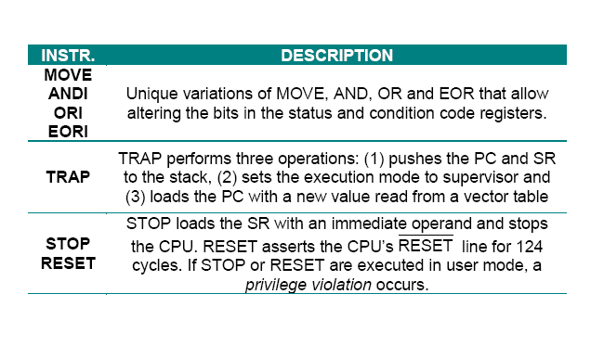
68000 System Control
to CCR, to SR
http://easy68k.com/easy68kexamples.htm

Slide 73
Summary of Data Transfer Instructions
LEA Load effective address
MOVE Move data
MOVEA Move address
MOVEM Move multiple registers
MOVEP Move peripheral data
MOVEQ Move quick
SWAP Swap register halves

Slide 74
Summary of Arithmetic Instructions
ADD Add binary
ADDA Add address
ADDI Add immediate
ADDQ Add quick
CLR Clear operand
CMP Compare
CMPI Compare immediate
DIVS Divide signed number
DIVU Divide unsigned
MULS Multiply signed number
NEG Negate
SUB Subtract binary
SUBA Subtract Address
SUBI Subtract immediate
SUBQ Subtract quick
EXT Extend sign

Slide 75
Summary of Logical and Shift Instructions
AND Logical AND
ANDI AND immediate
OR Logical OR
ORI OR immediate
EOR Exclusive OR
EORI Exclusive OR immediate
NOT Logical complement
ASL Arithmetic shift left
ASR Arithmetic shift right
LSL Logical shift left
LSR Logical shift right
ROL Rotate left
ROR Rotate right

Slide 76
Summary of Bit Manipulation Instructions
BCHG Bit change
BCLR Bit clear
BSET Set bit
BTST Test bit

Slide 77
Summary of Program Control Instructions
Bcc Branch on state of conditional code (cc) flag
BRA Branch always
BSR Branch to subroutine
JMP Unconditional jump
JSR Jump to subroutine
RTR Return and restore
RTS Return from subroutine

Slide 78
Summary of Privileged Instructions
ANDI SR And immediate to Status Register
EORI SR Exclusive OR immediate to Status Register
MOVE SR Move to/from the Status Register
MOVE USP Move to/from USP
RESET Reset the processor
RTE Return from exception
STOP Stop the processor
CHK Check register
ILLEGAL Force an illegal instruction exception
TRAP Trap call
TRAPV Trap on overflow
ANDI CCR AND immediate to condition code register
ORI CCR OR immediate to condition code register
EORI CCR Exclusive OR immediate to CCR
MOVE CCR Move to/from CCR
NOP No operation - Do nothing

